Slide 1
Costing for materials

Slide 2
LEARNING OUTCOMES:
Describe materials input to production process.
Apply procedures for purchasing, issuing, pricing and accounting for materials costs.
Apply procedures of store keeping, stores issues and stock valuation

Slide 3
Materials –meaning
Materials are things that are converted in to finished goods in association with the direct labor and direct expenses.
Material input to the production process can be in the form of raw materials, work in progress and finished products depending on the stage they are in the production process.
It forms a large part of total cost of finished goods in most of manufacturing industries.

Slide 4
Materials -classifications
Based on the role they play in the production, materials can be classified as direct or indirect.
Direct materials: Materials that can be specifically attributed to a particular unit of production or job or service provided.
Indirect materials: The one which can not directly attributed to a specific unit of output or job or service provided.

Slide 5
Further classification
As an element of input, material can be classified according to:
Physical properties: color, shape, flexibility, quality, water/fire resistance.
Substance: wood, plastic, metal, wool, glass
Measurement: litre, meter, kilograms, bags, packets, numbers

Slide 6
Material management
It is the act of ensuring that the acquisition, issuing, storage handling and usage of materials are fully controlled at all time.
It must be assured that materials are available at the right quality and quantity at different phases of production.

Slide 7
Material management-Objectives
Matching the quality of raw materials with the product specifications.
Acquiring right materials at right quality, right quantity and right price.
Avoiding stock-out or zero inventory position so as to avoid shortage or non availability of required materials.
Avoiding having unnecessary excess inventory.
Minimizing wastage of materials during storage and production process

Slide 8
Material management
Material Control predict a proper organization for the efficient purchasing and storing of the materials, and for making them issued to the departments or the cost-centers in appropriate quantities, at the proper times and valued at the right prices.
Materials control aims at keeping the material cost within reasonable limits, budgets or standards

Slide 9
Material management
The process of material control system involves Purchasing procedures, Receipt and inspection of materials, Store keeping, Stock control, Issuing of materials, Pricing of materials and allocation of materials costs.

Slide 10
Purchasing procedures
Purchasing procedure involves the following decisions:
What to purchase;
When to purchase;
Form whom to purchase;
How much to purchase, and
Finally at what price the material should be purchased

Slide 11
Purchasing procedures-logical steps to be followed
Purchase requisition
Receiving the material supplies
Issuing good receipt note
Preparation and execution of purchase order
Inspection and testing of the materials
Source of materials supply and selecting supplier

Slide 12
1: Purchase requisition
Any department that requires the material they have to request from the stores by preparing a purchases requisition form.
Purchases requisition includes Date, Originating Department, Complete Description of material desired, Other Special Information, Date on which material is required for use, Signature of issuing authority of requisition.

Slide 13
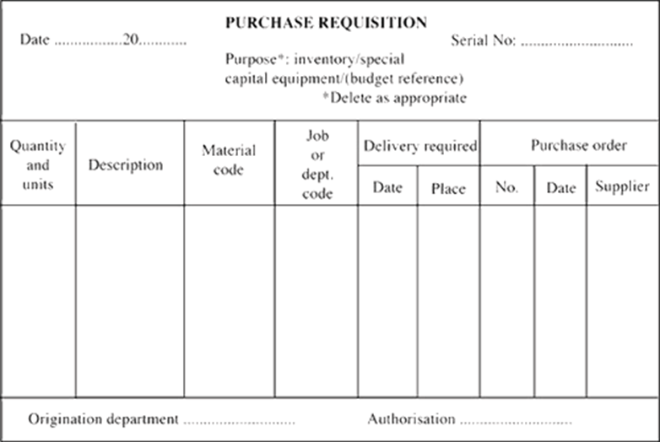
Purchase requisition- example

Slide 14
2: Letter of enquiry
Procurement department send letter of enquiry various suppliers to find out the prices and quality of goods.
3: Quotations
A quotation is an offer to supply goods according to the terms and terms and specification stated.
Quotations are response to the letter of enquiry

Slide 15
4: Selection of Source
Sources of supply has to be limited on the basis of:
On the basis of financial resource: Purchase department will see his pocket before selecting the source.
Service after buying: Purchase department will choose that supplier which provides the service after buying.
On the basis of sample: Purchase department will get the sample for selecting the source of supplier.

Slide 16
5: Placing of Order (PO):
When the source of supplier is selected, purchase department places his purchase order.
Purchase order is the written agreement in which purchaser and sellers will bind its terms and condition.
When the purchase order is issued to a supplier within the country then it is known as Local Purchase Order (LPO)

Slide 17
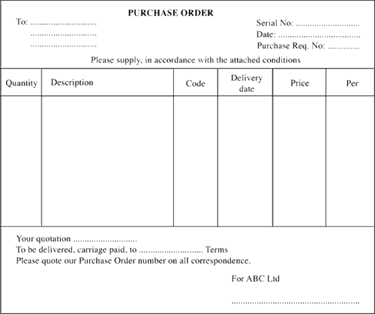
Purchase order-Example

Slide 18
6: Receipt and Checking of Goods
On receipt of the goods, good received note will be issued by the buying organization.
Advice note is issued when good have been delivery through public transport to inform the buyer that the goods have been dispatched.
The purchasing department has to inspect the goods before the delivery note is signed.
If the goods are rejected the purchasing department has to prepare the goods rejection note

Slide 19
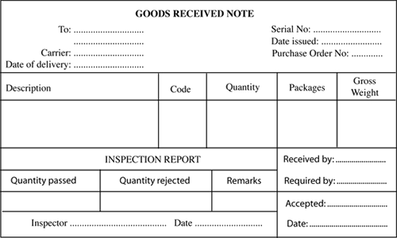
Good received note - Example

Slide 20
7: Invoice
After the delivery of the goods, supplier has to send an invoice to the purchasing department.
This document provides details about the quality, Quantity price and the total amount owed.
The invoice shows the claim of money from supplier to the buyer.

Slide 21
8:Payments
The payment may be made by cash or by cheque.
When money is received by the he has to issue a receipt to prove that the money has been received from the buyer.

Slide 22
9: Recording of purchases
The purchased goods are recorded in the book of accounts
The storekeeper uses the good received note to record the receipt of the goods in the books.
The entries made by the financial accountants are based on invoice

Slide 23
Issue of materials
The store keeper is responsible for issuing the materials to other departments like Production department.
The authorized for issuing materials from store is called materials requisition note/slip
Materials issue note/slip is used for issuing materials from store.
Material issue note shows details of materials issued, material requisition number and the signature of the person who issue and receive the material. Its information is useful for preparation of cost accounts.

Slide 24
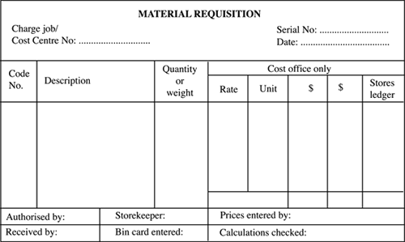
Materials requisition note-Example

Slide 25
Store keeping
Means keeping of materials in the store and keeping of the store records.
It is the responsibility of the store department to make sure that the materials received are stored until they are required by the use or production.
Records about receipt and issue of materials and the balance remained/held in the store are also adequately maintained to provide information.

Slide 26
Features of Effective Store keeping
Immediate location of materials
Full identification of all materials
Speeding the receipt and issue of material
Keeping correct and up-to date records of receipt, issue and stock balance of materials
Protection of materials from pilferage and deterioration

Slide 27
Features……
Protection of materials from theft and fire by:
Having fire protection devices
Not including explosive in the same room or under high pressure
Having theft protection devices
Economic use of the store storage space

Slide 28
Systems of store keeping
Centralized stores: materials or items are kept in one central store and are issued in one central point
Decentralized stores: materials are held in different stores (sub stores) i.e. each department stores their own materials.
Imprest stores: materials are received by the central stores and are then distributed to some sub stores in imprest system.

Slide 29
Stores Records
Stock records refer to documents which give information regarding the movement of stock.
The store keeper must keep records about materials received and issued from the store.
Bin card and store ledger are the main documents.

Slide 30
Bin Card/Bin Tag / Stock card
A card showing quantitative record of the receipts, issues and closing balances of the material kept in the corresponding bin/shelf.
Separate Bin cards are prepared for each item of stores.
It help to find out the number of various items in store on a particular date.

Slide 31
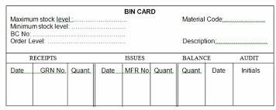
Bin card format

Slide 32
Stores Ledger
Is a record of stores, both in quantity and value.
The main difference with bin card is that value of material is shown in the Stores ledger.
It contains three columns; receipt, issue and the stock balance in hand.
There is further subdivision of columns in to quantity, price, and the value in total.

Slide 33
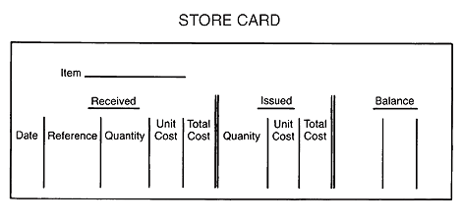
Store ledger format

Slide 34
Stock taking
The process of physically checking (counting) the material (Stocks) in the store to ensure that they are in correct amount.
It involves counting and making comparisons of the stock quantities shown in the records and actual quantities held in the store

Slide 35
Systems of stock taking
Perpetual stock taking/continuous stock taking
stock taking is done after each consumption or transaction.
Periodic stock taking
Stock taking, is done after a regular intervals/periodically. For example, after every one month, six months, etc.

Slide 36
STOCK CONTROL

Slide 37
Stock (inventory) control
Is the system used by the firm to control the stock in the store
Stock control means making sure that the business has the right quantity of goods, in the right place and right time.
Stock control necessitates the maintenance of sufficient inventory level of for every material required.
The scientific techniques are applied to control the inventory level

Slide 38
Stock control-Objectives
The main objectives of stock control involve the following:-
To ensure the availability of goods when required
To reduce the storage costs as much as possible
To minimize the risk of deterioration, theft and wastage.
To avoid over or under stocking.
To maintain accurate records.

Slide 39
Calculating Stock levels
To avoid over/under stocking each items of the inventory has the:
Maximum Level,
Minimum Level,
Average level,
danger level,
an Order point, and
order quantity.
In this part, we will learn how to calculate various inventory levels.

Slide 40
Maximum Stock level (MaxSL):
Indicates the maximum quantity of an item of material which can be held in stock at any time.
It can be calculated by applying the following formula:
MaxSL = Re-order level + Re-order quantity - (Minimum consumption × Minimum re-order period)

Slide 41
Minimum stock level
Represents the quantity below which the inventory of any items should not allow to fall.
Minimum level = Re-order level – (Normal consumption x normal re-order period)

Slide 42
Re-ordering Level
Is the point at which it becomes essential to initiate purchase orders for its fresh supplies.
To decide the Order Point, three factors are considered, viz., (1) Lead time (2) expected Usage during Lead time, and (3) Minimum Limit or the Safety stock.
Reorder level = maximum re-order period x maximum usage

Slide 43
Re-ordering Level………
Or;
Or;
Minimum level + consumption during time lag period
Maximum consumptions × lead time + safety stock

Slide 44
Example 1
Given that Materials X and Y are used as follows:
Minimum usage 50 units each per week, Maximum usage 150 units each per week, Normal usage 100 units each per week.
Ordering quantities: X 600 units, and Y 1000 units. Delivery period: X = 4 to 6 day, Y = 2 to 4 days.
Calculate for each materials, Maximum level, minimum level and ordering level.

Slide 45
Material X
Maximum stock level = Re-order level + Re-order quantity - (Minimum consumption × Minimum re-order period)
= 900 + 600 – (50 × 4)
= 1300 units
Reorder level Materials X
Reorder level = maximum re-order period x maximum usage.
= 150 × 6
= 900 units
Minimum level = Re-order level – (Normal consumption x normal re-order period)
= 900 – (100 × 5)
= 400 units

Slide 46
Material Y
Reorder level = maximum re-order period x maximum usage.
= 150 × 4
= 600 units
Minimum level = Re-order level – (Normal consumption x normal re-order period)
= 900 – (100 × 3)
300 units
Maximum stock level = Re-order level + Re-order quantity - (Minimum consumption × Minimum re-order period)
= 600 + 1000 – (50 × 2)
= 1500 units
Note: Normal re-order period = Max. Re-order period + Min. Re-order period
2

Slide 47
The optimum/Economic order quantity
It is the quantity that should be ordered at one time so as to minimize the total costs of having stocks.
The costs of having stock can be broken down in two parts:-
Holding costs which comprises of; Cost of capital tied up, Warehousing costs, Deterioration, Obsolescence, Insurance

Slide 48
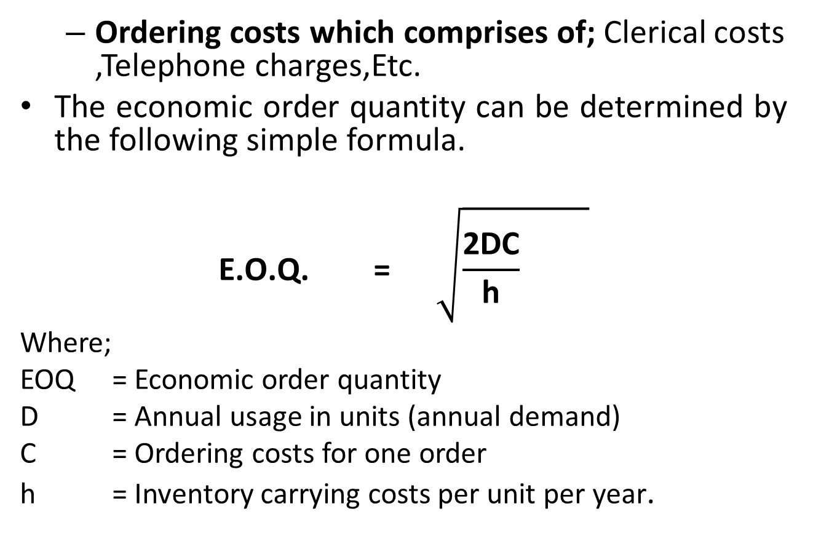
Ordering costs which comprises of; Clerical costs ,Telephone charges,Etc.
The economic order quantity can be determined by the following simple formula.
$$\text{E}\text{.}\text{O}\text{.}\text{Q}\text{. =} \sqrt{\frac{\text{2}\text{DC}}{\text{h}} }$$
Where;
EOQ = Economic order quantity
D = Annual usage in units (annual demand)
C = Ordering costs for one order
h = Inventory carrying costs per unit per year.

Slide 49
Example 2
ABC manufactures a product and the following particulars are collected for the year ended March, 2024.
Monthly demand (units) 250
Cost of placing an order TSH 1000
Annual carrying costs TSH 150 per unit
Normal usage (Units per week ) 50
Minimum usage (Units per week) 25
Maximum usage (units per week) 75
Re-order period (weeks) 4-6 weeks
You are required to calculate:
Re-order quantity
Re-order level
Minimum level
Maximum Level
Average stock level.

Slide 50

Solution
$\text{E}\text{.}\text{O}\text{.}\text{Q}\text{. =} \sqrt{\frac{\text{2×}\text{3000}\text{×}1000}{\text{150}}}$
= 186 units
ii. Re-order level = Max. re-order period × Maximum usage
= 6 weeks × 75
= 450 units

Slide 51
iii: Minimum level = Re-order level – (Normal usage × normal re-order period)
= 450 units – (50units × 5 weeks)
= 200units
iv: Maximum level = re-order level + re-order quantity – (Minimum usage × minimum delivery period).
= (450 units + 186 units) – ( 25 units × 4 weeks)
= 536 units

Slide 52
V. Average stock level = Max. level + Min. Level
2
= 536 + 200
2
= 368 units.

Slide 53
RECORDING OF MATERIAL COST
Recording the cost of material needs to identify the type of material i.e. direct and indirect material.
Direct material cost are charged to the prime cost
Indirect material cost are charged to the overhead cost
It also needs to determine the material used in the production and the value of material (inventory) remained in the store.

Slide 54
RECORDING OF MATERIAL COST
Materials purchased:
Dr inventory (material control) account
Cr cash/account payables
Material issued to production
Dr: work in progress account (Direct materials)
Dr: factory overhead account (indirect materials)
Cr: Inventory (material control) account
Unused materials from production
Dr: Inventory (material control) account
Cr: work in progress account (Direct materials)

Slide 55
Example
A company manufactures a single product and has the following transactions for material for the particular period:
Raw materials purchased on credit from supplier Juma & Sons ltd. Tsh 5,000,000. Raw materials costing Tsh 100,000 were returned to supplier Juma & Sons ltd due to defects.
The total store requisitions for direct materials for the period was Tsh 4000,000
Total issue of indirect materials during the period were Tsh 150,000
Unused materials costing Tsh 50,000 was returned to the stores from production.
Required:
Prepared material control account for the period showing clearly how each transaction is treated.

Slide 56
Answer
Dr |  |  | CR
 | TSH |  | TSH
Account payables | 5,000,000 | Account payables | 100,000
Work in progress account | 50,000 | Work in progress account | 4000,000
 |  | Factory overhead account | 150,000
 |  | Closing balance (bal. figure) | 800,000
 | 5,050,000 |  | 5,050,000

Slide 57

ANY QUESTIONS

